Slide 1
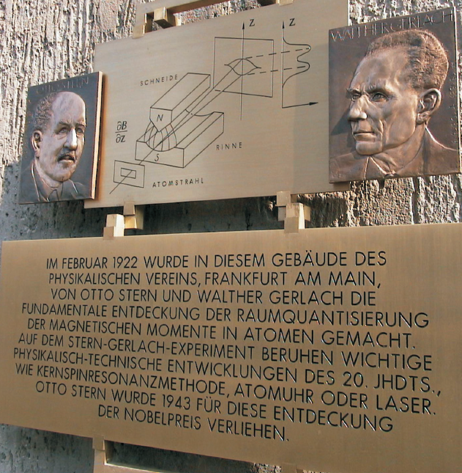
Stern-Gerlach-Eksperimentet 100 år
TFY4215 mandag
7. november 2022
Minneplakett i Frankfurt, Tyskland (2002)

Slide 2
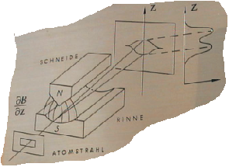
Oppsplitting i to stråler, Δz ~ 0.2 mm
Spalte med bredde 0.03 mm for å fokusere atomstrålen
Magnet, 3.5 cm lang, B ~ 0.1 T,
dB/dz ~ 10 T/cm
Stråle med sølvatomer, fra ovn med temperatur 1000 °C; fart ca 660 m/s

Slide 3
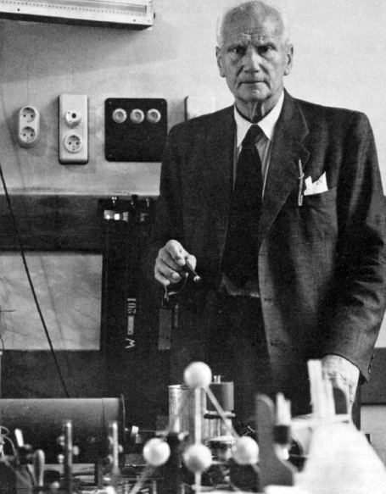
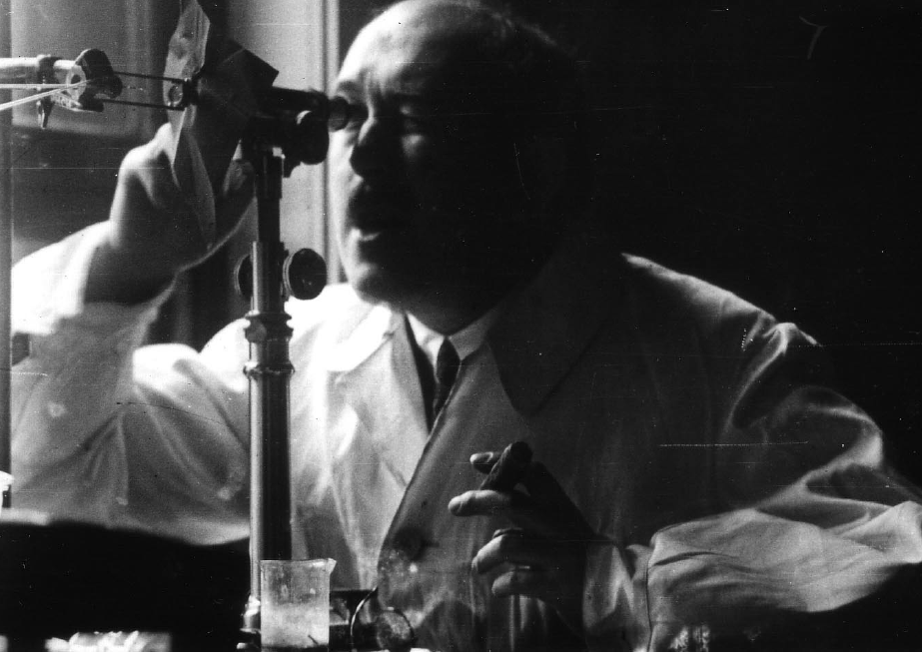
Otto Stern (Tyskland/Polen, 1888–1969), cigar in hand, working in his molecular beam laboratory at the Institute for Physical Chemistry in Hamburg, about 1930.
«After venting to release the vacuum, Gerlach removed the detector flange. But he could see no trace of the silver atom beam and handed the flange to me. With Gerlach looking over my shoulder as I peered closely at the plate, we were surprised to see gradually emerge the trace of the beam. . . . Finally we realized
what had happened. I was then the equivalent of an assistant professor. My salary was too low to afford good cigars, so I smoked bad cigars. These had a lot of sulfur in them, so my breath on the plate turned the silver into silver sulfide, which is jet black, so easily visible. It was like developing a photographic film.»
Walther Gerlach (Tyskland, 1889–1979), cigar in hand, in his laboratory at the Institute for Physics in Munich, about 1950.

Slide 4
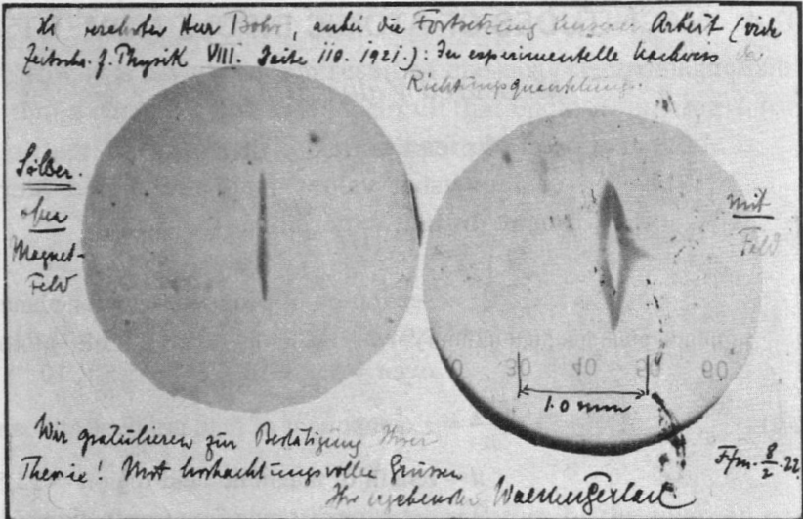
Gerlachs postkort 8. februar 1922 til Niels Bohr:
«Det eksperimentelle bevis på retningskvantisering. Vi gratulerer med bekreftelsen på Deres teori!
Med ærbødige hilsener,
Walther Gerlach»
«Sølv uten magnetfelt» «med felt»

Slide 5
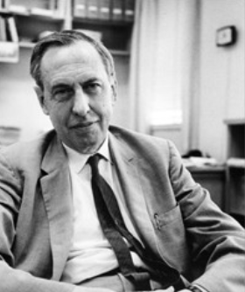
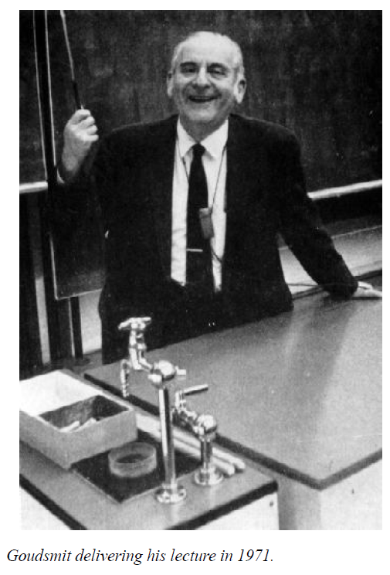
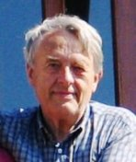
I 1925 foreslo hollenderne Samuel Goudsmit (1902-1978) og George Uhlenbeck (1900-1988) at elektronet har en kvantisert «indre dreieimpuls» – et spinn. Bakgrunnen for ideen var ikke Stern-Gerlach-eksperimentet (som de tilsynelatende ikke kjente til), men spektrallinjer i ulike eksperimenter som man ikke fikk til å stemme med rådende teori.
“What the historians forget - and also the physicists - is that in the discoveries in physics chance, luck plays a very, very great role. Of course, we do not always recognize this. If someone is rich, then he says "Yes, I have been clever, that is why I am rich"! And the same is being said of someone who does something in physics "yes, a really clever guy.....". Admittedly, there are cases like Heisenberg, Dirac and Einstein, there are some exceptions. But for most of us luck plays a very important role and that should not be forgotten.”
George Uhlenbeck
“When the day came I had to tell Uhlenbeck about the Pauli principle - of course using my own quantum numbers - then he said to me: "But don't you see what this implies? It means that there is a fourth degree of freedom for the electron. It means that the electron has a spin, that it rotates!"
Per Chr Hemmer (1933-2022) var Post Doc (Research Associate) hos Uhlenbeck ved The Rockefeller Institute i New York på begynnelsen av 60-tallet.

Slide 6
Litteratur:
«Stern and Gerlach: How a Bad Cigar Helped Reorient Atomic Physics», Friedrich and Herschbach, Physics Today 56, 12, 53 (2003)
«Goudsmit on the discovery of electron spin» (google!)
«George Uhlenbeck and the Discovery of Electron Spin», A. Pais, Physics Today 42, 12, 34 (1989)
…og referanser i disse artiklene

